Slide 1

Final Project Neo4j in Linguistics
Marshall, Alex
CSCI E-63 Big Data Analytics
Harvard University Extension School
Prof. Zoran B. Djordjević

Slide 2
Introduction
Problem Statement
Neo4j
Use Neo4j to graph texts with sentence nodes connected by both temporal order and Bag-of-Words cosine similarity edges to draw insight on their structure.
I will compare campaign speeches from Hillary Clinton and Donald Trump. My hypothesis is that I will find relatively more short, higher similarity cycles in Donald Trump speeches and long, lower similarity cycles in Hillary Clinton speeches.
Graph database management system
optimized for connected data
Traverses paths of connectivity much faster than RDBMSs and scales with little impact on performance
ACID compliant and accessible through bolt protocol or HTTP

Slide 3
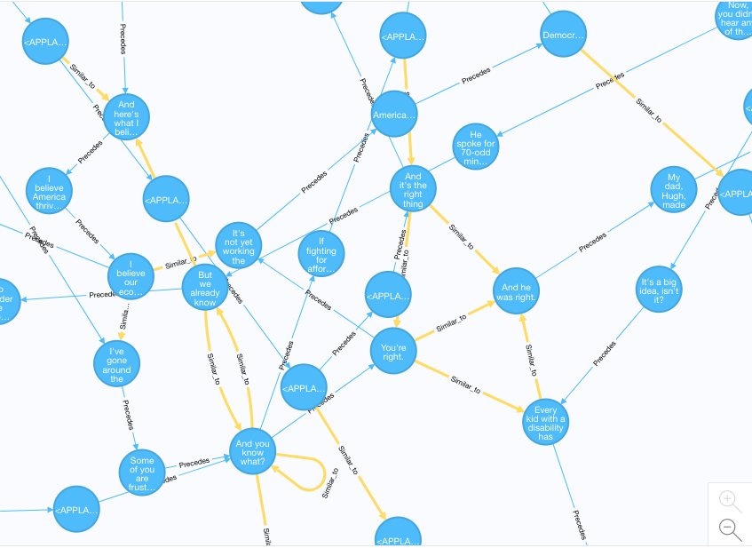

Slide 4
Software and Data
Data
Clinton Trump Corpus: http://www.thegrammarlab.com/?nor-portfolio=corpus-of-presidential-speeches-cops-and-a-clintontrump-corpus
Plain text documents of speeches delivered at campaign events by Hillary Clinton and Donald Trump.
Software:
Neo4j 3.0.5 (neo4j.com/download/)
Anaconda 4.3.30 (www.anaconda.com/download/)
Contains Python 3.6.3 and Jupyter Notebook 5.2.2
Python Packages:
Scikit-learn (scikit-learn.org/)
NLTK (www.nltk.org/)
Py2Neo (py2neo.org/v3/)
Numpy (www.numpy.org/)
Pandas (pandas.pydata.org/)
Scipy (www.scipy.org/)
Matplotlib (https://matplotlib.org/)

Slide 5
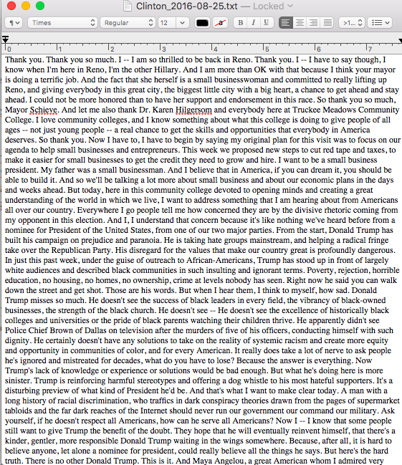
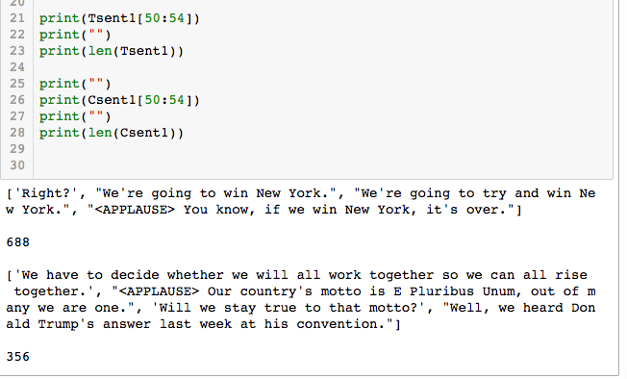
Prepare Data – Import and Tokenize
Import text documents into Python
Split the text into sentences - NLTK’s sent_tokenize()

Slide 6
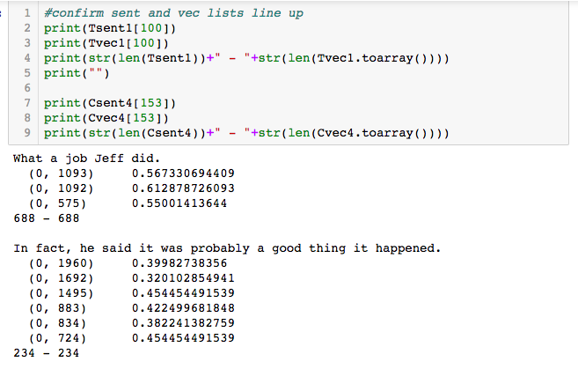
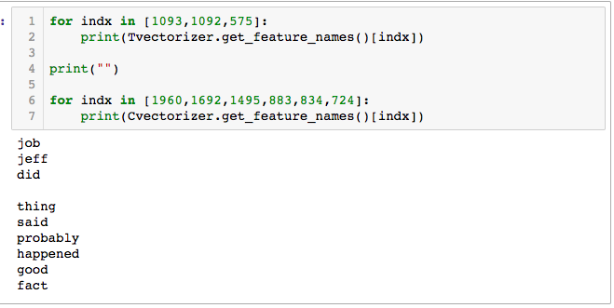
Prepare Data – Vectorize
Turn the sentences into word vectors which can be used to find cosine similarities between nodes.
Scikit-learn’s CountVectorizer to create vocabulary and transform text into one-hot encoded vectors
TfidTransformer to apply Term Frequency – Inverse Document Frequency to vectors

Slide 7
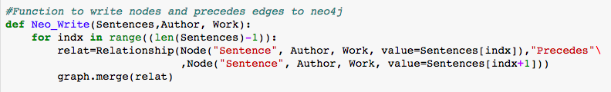
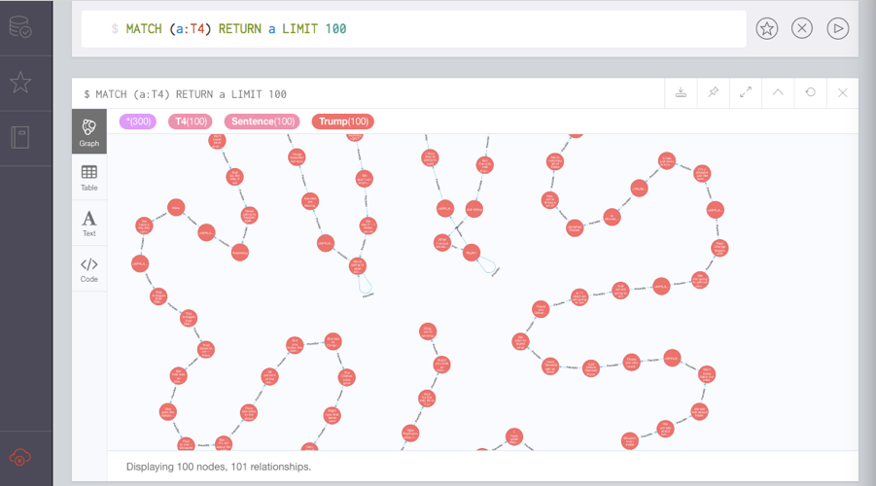
Write to Neo4j – Precede edges
Iterate through the sentence lists to create graph of sentence nodes with “Precedes” edges

Slide 8
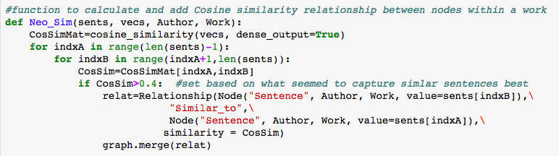
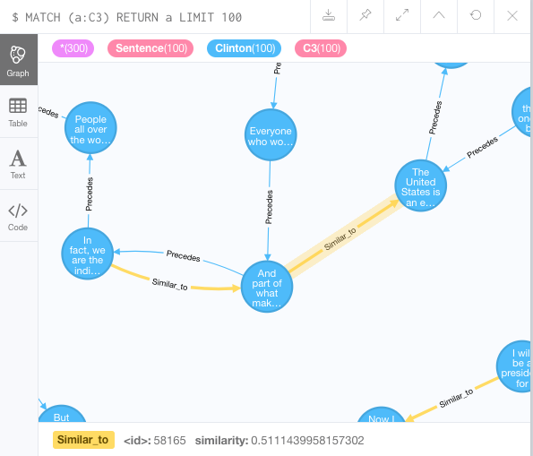
Write to Neo4j – Similar_to edges
Calculate cosine similarity between nodes with scikit-learn’s cosine_similarity
Create edge between upstream nodes if cosine similarity meets a threshold
I set at 0.4

Slide 9
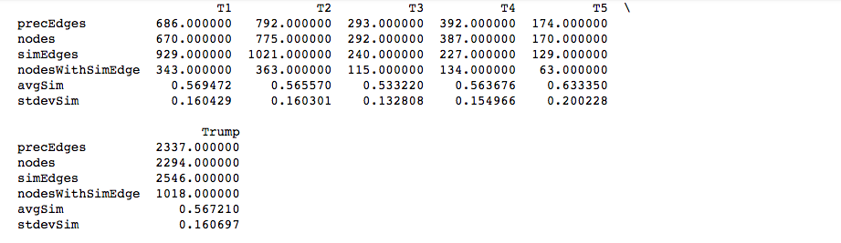
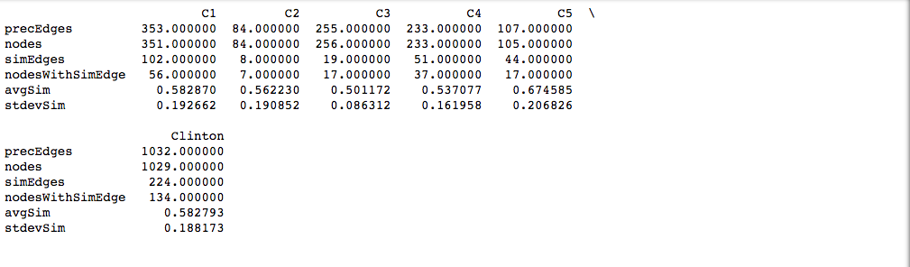
Metrics – Summary Stats

Slide 10
Metrics – Summary Stats
Best comparison is nodesWithSimEdge related to Nodes
nodesWithSimEdge is the number of nodes with at least one Similar_to edge pointing away from it
CypherQL: Match (a:label)-[:Similar_to]->(b) RETURN count(DISTINCT a)
Trump’s nodesWithSimEdge is around a half of the number of nodes
Clinton’s nodesWithSimEdge are at most a fifth of the total nodes.

Slide 11
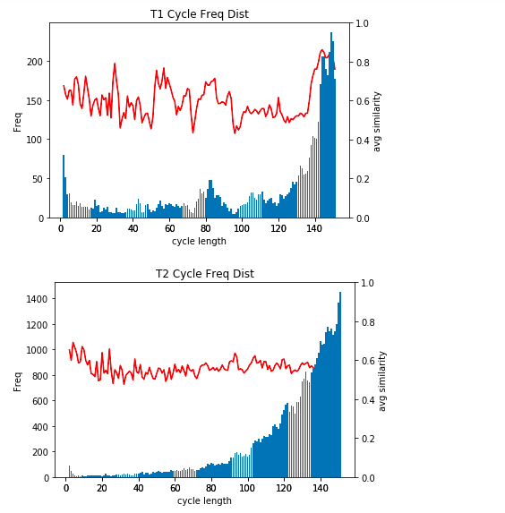
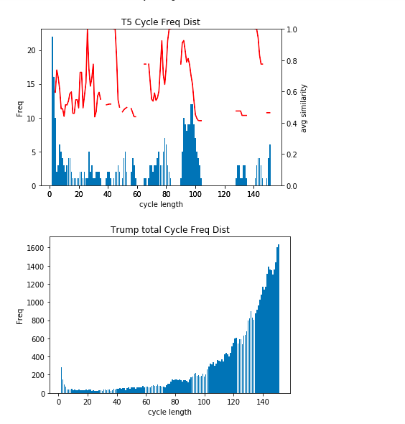
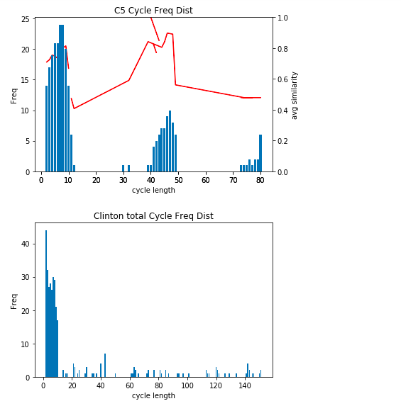
Metrics – cycle length freqs

Slide 12
Metrics – cycle length freqs
In general, frequency is higher at lower cycle lengths but occasionally there are large spikes at longer frequencies
Frequencies grow exponentially in T2
The total chart for Trump speeches is largely driven by T2

Slide 13
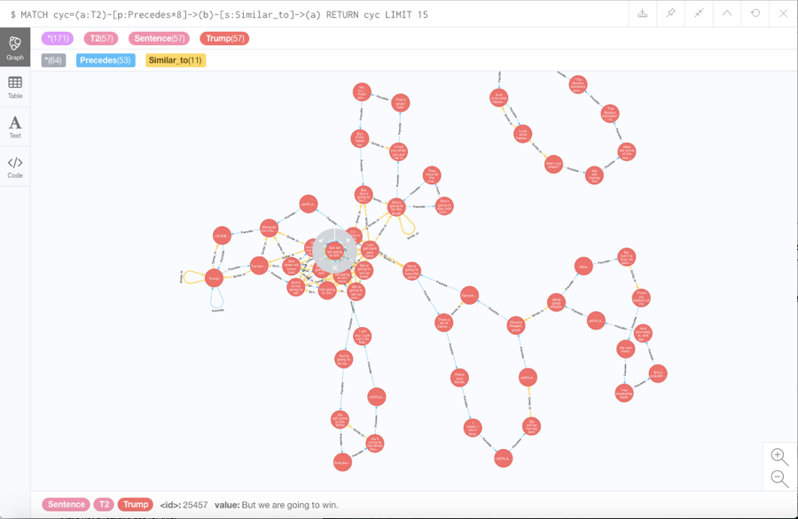
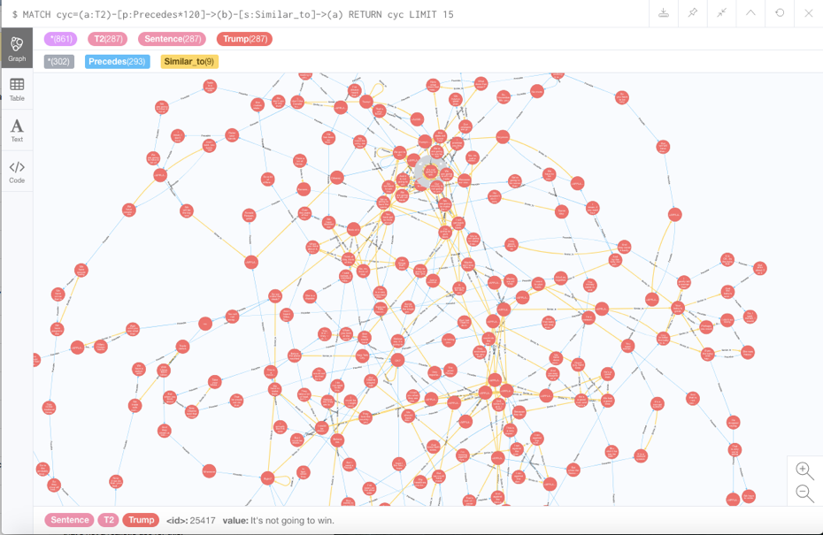
Visualization
Clusters of similar sentences are responsible for most of the cycles
Ex. Donald Trump saying “win”

Slide 14
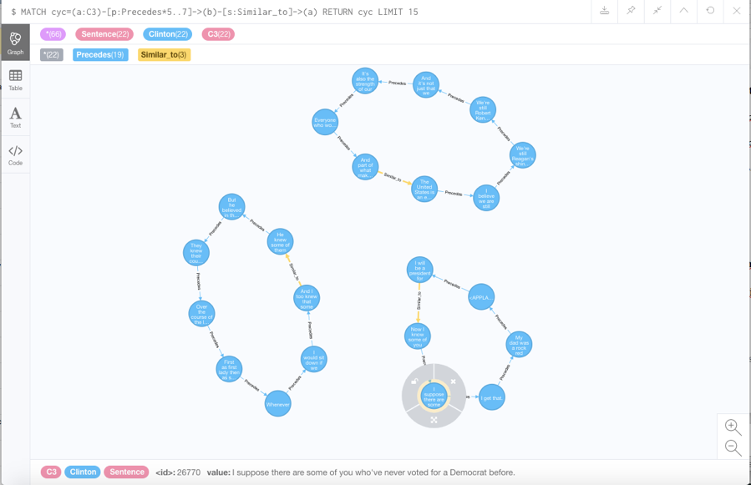
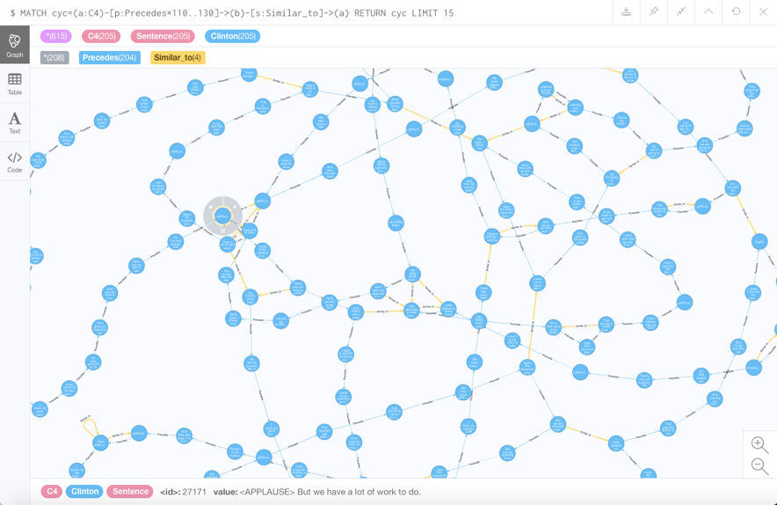
Visualization
Still get some nice results
Themes emerge from larger cycles
Ex. Hillary Clinton’s “Lot of work to do” and “Stronger together”

Slide 15
Lessons Learned
Donald Trump speeches contain many more similar sentences than Hillary Clinton’s
Neo4j is very useful modelling text as sentences
Robust Visualization with user friendly UI and query language
Efficient traversal through connections
My method has potential but limited usefulness without further modifications
Great at measuring repetition but not yet effective in finding themes or other structural patterns
Multiple similar sentences add lots of noise to results especially when said in close proximity (ie “thank you”)

Slide 16
YouTube URLs
Two minute (short): https://youtu.be/ZhZqxxkMmu0
15 minutes (long): https://youtu.be/8xwWGrvepig

Slide 17
References
Neo4j logo. Neo4j, Inc. Retrieved from https://neo4j.com/
Hillary Clinton Image. “Full text of Hillary Clinton speech”. CNN. Retrieved from http://cdn.cnn.com/
Donald Trump Image. “If you get your news from conservative media, Trump-russia story is still ‘fake’” . NCPR. Retrieved from https://www.northcountrypublicradio.org
Py2neo logo. “The Py2neo v3 Handbook”. Retrieved from http://py2neo.org/v3/

